Slide 1

LEADSSCORE CASE STUDY
Nithish G

Slide 2
Problem Statement
An education company named X Education sells online courses to industry professionals. On any given day,
many professionals who areinterested in the coursesland on their website and browse for courses.
The company markets its courses on several websites and search engines like Google. Once these people land on the website, they might browse the courses or fill up a form for the course or watch some videos. When these people fill up a form providing their email address or phone number, they are classified to be a lead. Moreover, the company also gets leads through past referrals. Once these leads are acquired, employees from the sales team start making calls, writing emails, etc. Through this process, some of the leads get converted while most do not. The typical lead conversion rate at X education is around 30%.
Now, although X Education gets a lot of leads, its lead conversion rate is very poor. For example, if, say, they acquire 100 leads in a day, only about 30 of them are converted. To make this processmore efficient, the company wishes to identify the most potential leads, also known as ‘Hot Leads’. If they successfully identify this set of leads, the lead conversion rate should go up as the sales team will now be focusing more on communicating with the potential leads rather than making calls to everyone.

Slide 3
Goal of the Case Study:
Build a logistic regressionmodel to assign a leadscore between 0 and 100 to each of the leads which can be used by the company to target potential leads. A higher score would mean that the lead is hot, i.e. is most likely to convert whereas a lower score would mean that the lead is cold andwill mostly not get converted.
There are some more problems presented by the company which your model should be able to adjust to if the company's requirement changes in the future so you will need to handle these as well. These problems areprovided in a separate doc file. Please fill it based on the logistic regression model you got in the first step. Also, make sure you include this in your final PPT where you'll makerecommendations.

Slide 4
Reading and understanding the data
Data Cleaning
Delete high null values
Handle categorical null values
Handle numerical null values
Exploratory Data Analysis
Data Imbalance check
Univariate analysis
Data Preparation
Outlier treatment
Convert binary categories
Create dummy variables
Train Test Split
Feature Scaling
Model Building
SOLUTION METHODOLOGY
Model Evaluation
Conclusion

Slide 5
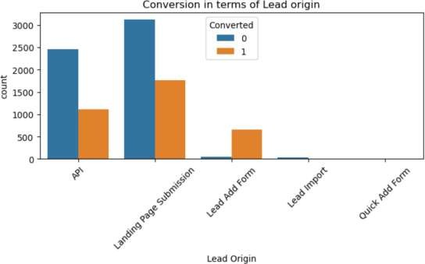
EDA Lead Origin
Observation From the above plot and Lead origin conversion summary, we can infer that: Lead Add Form has the highest conversion rate at 92% API and Landing Page Submission have 31% and 36% conversion rate but they generate maximum leads counts. Lead Import has the least amount of conversions and leads count. Toimprove overall lead conversion rate, focus should be on improving lead conversion rate of API and Landing Page Submission.Also, generate more leads from Lead Add form since they have a very good conversion rate

Slide 6
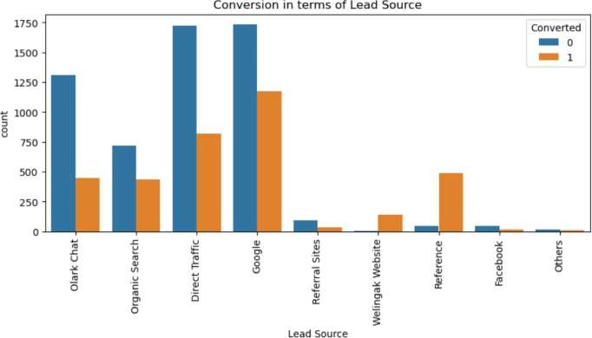
EDA Lead Source
Google and direct traffic generates maximum number of leads but has conversion rate of 40%and 32%.
Welingak website and References has
highest conversion ratesaround 98% and 93% but generates less number of leads.

Slide 7
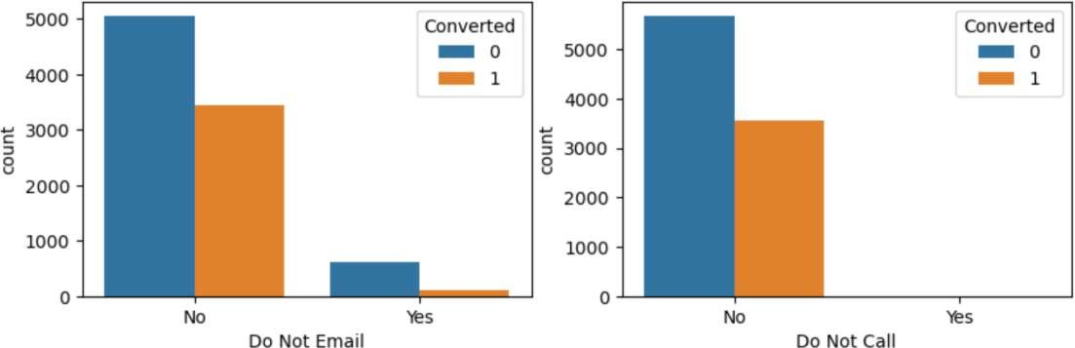
Do Not Email & Do Not Call
Most of the customersdo not liketo be called or receiveemails about the course.

Slide 8
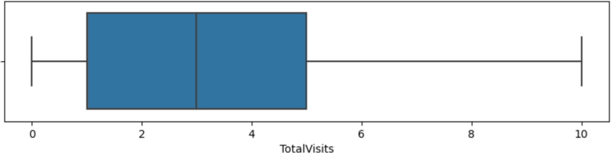
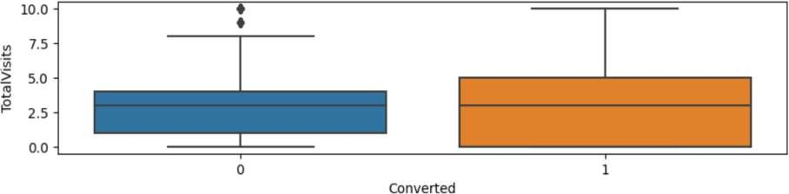
Total visits

Slide 9
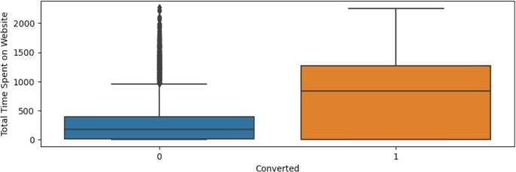
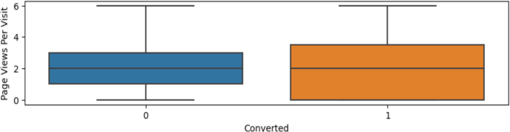
The total time spent on website is directlyproportional to conversion rate
Total Time Spent on Website
Page Views Per Visit
9

Slide 10
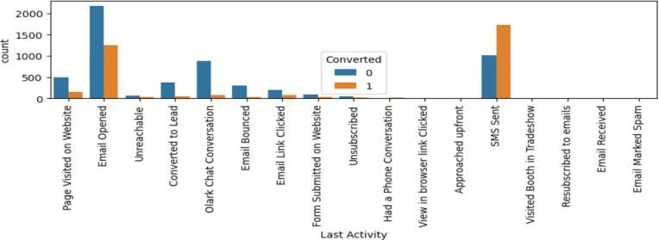
Last Activity
Maximum leads are generatedfrom people with last activity - Email openedand SMS sent.
Conversion rate is around 63% and 36% .
Toimprove overall leadconversion rate, focus should be on improving leadconversion of people with last activity -olark chat conversation, SMS sent and Page Visited on Website .

Slide 11
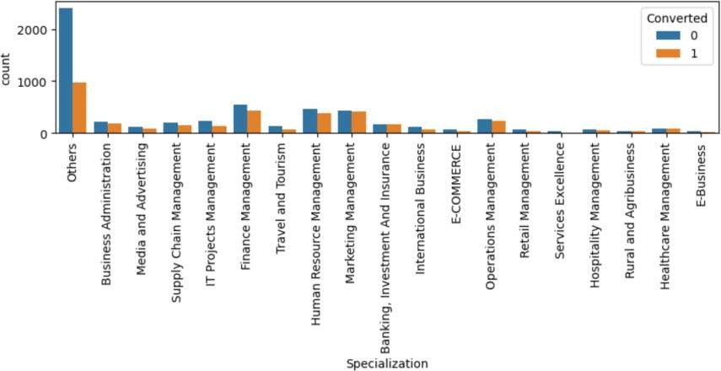
Specialization

Slide 12
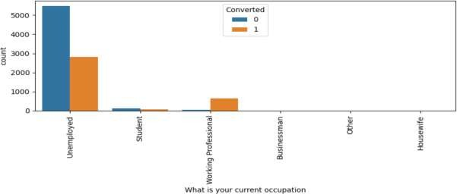
What is your current occupation ?
Working Professionals and Unemployed people generates maximum leads .
12

Slide 13
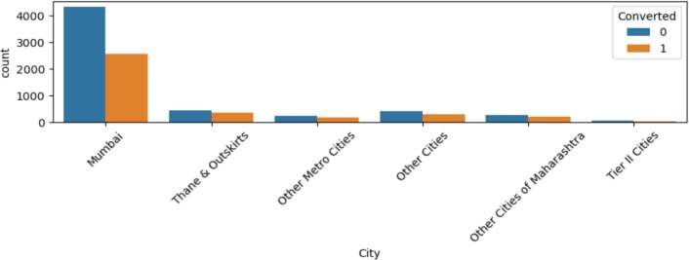
City
Maximum leads are generated from Mumbai city with conversion rate of around 36% .Hence focus should me
more on increasingconversion rate of Mumbai city
13

Slide 14
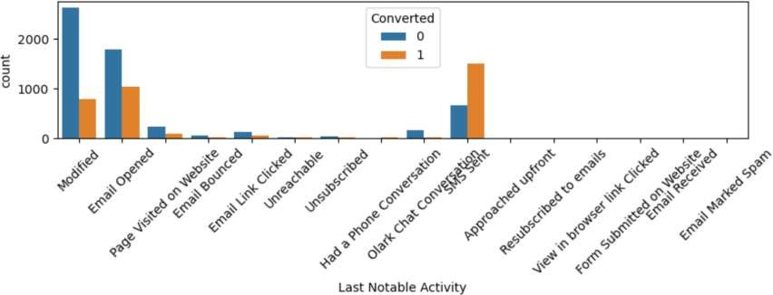
Last Notable Activity
14

Slide 15
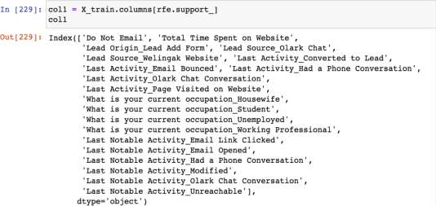
Data Preparation
Create dummy variablesfor categoricalvariables
Drop originalcolumns
Train Test Split
Train size – 70% of thedata
Testsize – 30% of the data
Feature Scaling
Usingstandard scalar we scale the below columns
Total Visits, Total Time Spent onWebsite, Page Views Per Visit
Feature selection usingRFE
Using RFEfunctionwe select 20 variableswhichwould helpthemost formodelbuilding

Slide 16
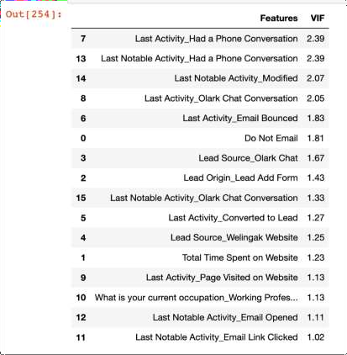
Model Building
We use GeneralizedLinear Model to build themodel
We use Variance Inflation Factor (VIF) and P value to drop the unwanted columns
After iterating few times we decidewithset of columns to start predicting
Once we are done withthe column selection we can start predictingand evaluating the model
We have thebelow results once we evaluatethe model
Sensitivity : 70 %
Specificity :89%
16

Slide 17
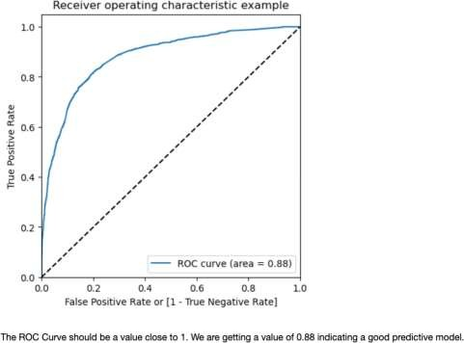
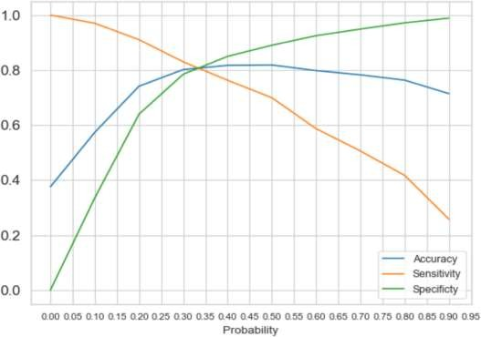
Plotting the ROCCurve
tellshowmuchthemodelis capable of distinguishing betweenclasses
Finding the optimal Cut offPoint
17

Slide 18
Fromthe above curve we cansee that theoptimalcut-off is at 0.35. This is the point where all the parameters-Accuracy,Sensitivity,Specificity areequallybalanced
We will onlyconsider data with probability>0.35
Once we havethedata ,we canstartpredictingand checkingthe accuracy
Below are theresults
Overall Accuracy:81 %
Specificity :81%
Sensitivity :80%
When we areselecting the optimalcut-off = 0.35, thevarious performanceparametersAccuracy, Sensitivity& Specificity areall 80%
Precision andRecall
precision and recall whichtells us thescore for result relevancy and howmanytrulyrelevantresults arereturned
Below are theresults
Precision score: 72 %
Recall score: 80 %
Making Predictions ontest set
Once we test the model on test data belowarethe results:
Overallaccuracy :81%
Sensitivity :80%
Specificity :82%
Precision Score :75%
Recall Score :80%

Slide 19
Final Observation
Letscomparethe Model Performance parameters obtainedfor Train & Test data:
Train Data:
Accuracy:81%
Sensitivity:79%
Specificity :81%
Precision score:72%
Recall score :80%
TestData:
Accuracy:81%
Sensitivity:80%
Specificity :82%
Precision Score:75%
Recall Score :80%
We got around 1% difference on train andtest data's performance metrics. This impliesthat our finalmodeldidn'toverfit training data and is performingwell.
High Sensitivity willensure that almostallleadswhoare likelyto Convert are correctly predicted whereas high Specificity willensure that leadsthat are on the brink of theprobability of getting Converted or not are not selected.
Depending on the business requirement, we can increase or decrease the probability threshold valuewith in turnwill decrease or increase the Sensitivity and increase ordecrease the Specificity of the model.
19

Slide 20
Recommendations
Thesalesteam of the X-Educationshould focus on the leadshavingleadorigin- leadadd form ,occupation - Working Professional , Lead source - Welling Akwebsite.
Sales Teamof the companyshould firstfocus on the 'Hot Leads’
The'Cold Leads'(Customerhavingleadscore <= 35) should be focused afterthe Sales Teamis done with the 'Hot Leads'.
High Sensitivity willensure thatalmost all leads who arelikely to Convert arecorrectlypredictedwhere as high Specificitywill ensurethat leads thatare on the brink of theprobability of getting Converted or notarenot selected.
We have high recall scorethanprecision score.Hencethismodelhas an abilityto adjustwith the company’srequirements in
coming future.
Its betterthat we canaskstudentsto fillmany important fields likelocation detailswhich can be used for futher analysis
We canignorecustomers who do not want to be calledaboutthe course.
If the Last NotableActivityis Modified, he/shemay not be theconverted to lead
20

